Slide 1

DATA ANALYTICS PROJECT
Predicting Used Car Prices
Presentation by: Ezekiel Ibe

Slide 2
Agenda
Business Understanding
Data Understanding
Data Preparation
Modeling
Evaluation
Deployment

Slide 3
Business Understanding
What does the business need?
Assess Situation
Inventory of Resources Requirements, Assumptions, and Constraints Risks and Contingencies Terminology Costs and Benefits.
Project Plan
Project Plan Initial Assessment of Tools and Techniques

Slide 4
Business Understanding
Assessing the situation
The prices of new cars in the industry is fixed by the manufacturer with some additional costs incurred by the Government in the form of taxes. So, customers buying a new car can be assured of the money they invest to be worthy. But due to the increased price of new cars and the incapability of customers to buy new cars due to the lack of funds, used cars sales are on a global increase (Pal, Arora and Palakurthy, 2018). There is a need for a used car price prediction system to effectively determine the worthiness of the car using a variety of features.

Slide 5
Business Understanding
The Target (Client)
Used car sellers (dealers): They are one of the biggest target group that can be interested in results of this study. If used car sellers better understand what makes a car desirable, what the important features are for a used car, then they may consider this knowledge and offer a better service.
Individuals: There are lots of individuals who are interested in the used car market at some points in their life because they wanted to sell their car or buy a used car. In this process, it’s a big corner to pay too much or sell less then it’s market value.

Slide 6
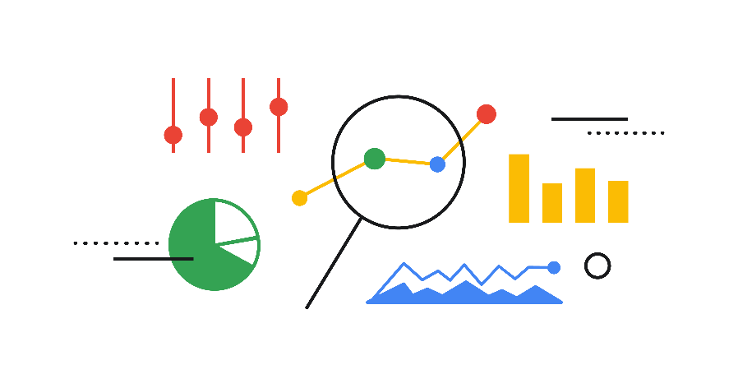
data Understanding
Collect Initial Data
Initial Data Collection Report
Describe Data
Data Description Report
Explore Data
Data Exploration Report
Verify Data Quality
Data Quality Report

Slide 7
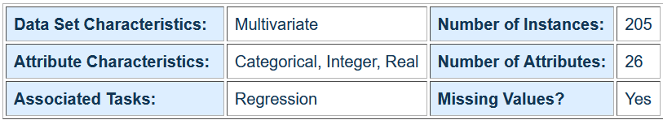
Data Understanding
The Data: Automobile Data Set
The data used in this project was downloaded from UCI Machine Learning Repository.
Sources:
1985 Model Import Car and Truck Specifications, 1985 Ward's Automotive Yearbook.
Personal Auto Manuals, Insurance Services Office, 160 Water Street, New York, NY 10038
Insurance Collision Report, Insurance Institute for Highway Safety, Watergate 600, Washington, DC 20037

Slide 8
Data Understanding
The Dataset Information
This data set consists of three types of entities:
the specification of an auto in terms of various characteristics,
Its assigned insurance risk rating,
Its normalized losses in use as compared to other cars.
The second rating corresponds to the degree to which the auto is more risky than its price indicates. Cars are initially assigned a risk factor symbol associated with its price. Then, if it is more risky (or less), this symbol is adjusted by moving it up (or down) the scale. Actuarians call this process "symboling". A value of +3 indicates that the auto is risky, -3 that it is probably pretty safe.

Slide 9
Data Understanding
The Dataset Information
The third factor is the relative average loss payment per insured vehicle year. This value is normalized for all autos within a particular size classification (two-door small, station wagons, sports/speciality, etc...), and represents the average loss per car per year.

Slide 10
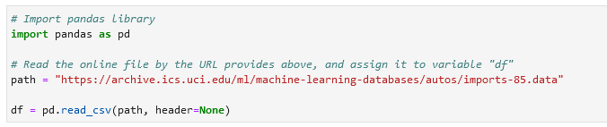
Data Understanding
The Dataset Acquisition & Basic Insight
Read Data
We use pandas.read_csv() function to read the csv file. In the brackets, we put the file path along with a quotation mark so that pandas will read the file into a dataframe from the address as outlined in the below screenshot.

Slide 11
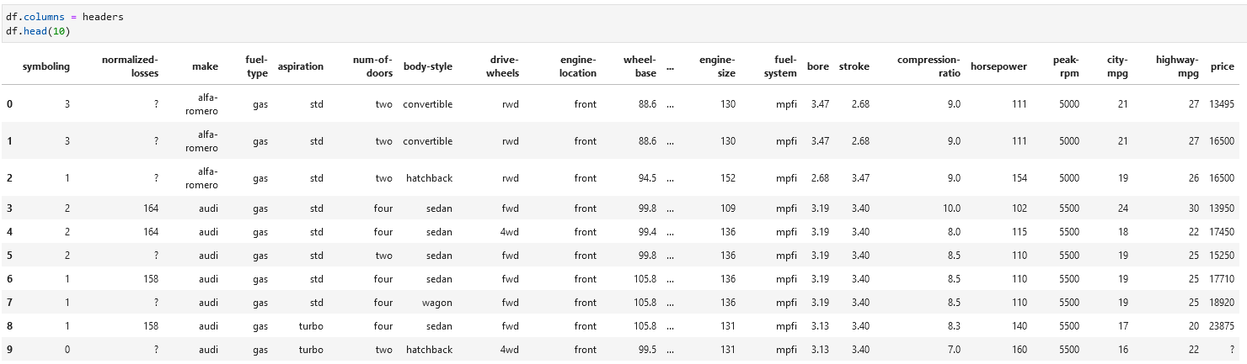
Data Understanding
The Dataset Acquisition & Basic Insight
Creating the Data frame
To better describe our dataset header were introduced for attributes information

Slide 12
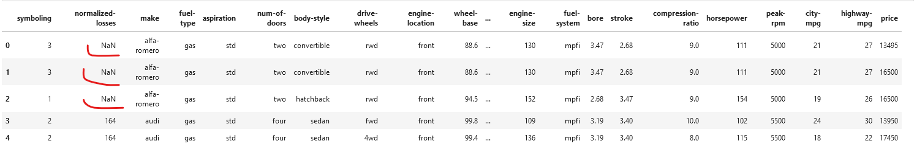
Data Understanding
The Dataset Acquisition & Basic Insight
Missing values were observed as ‘?’ symbol and were replaced with NaN (Not a number) which was subsequently dealt with.

Slide 13
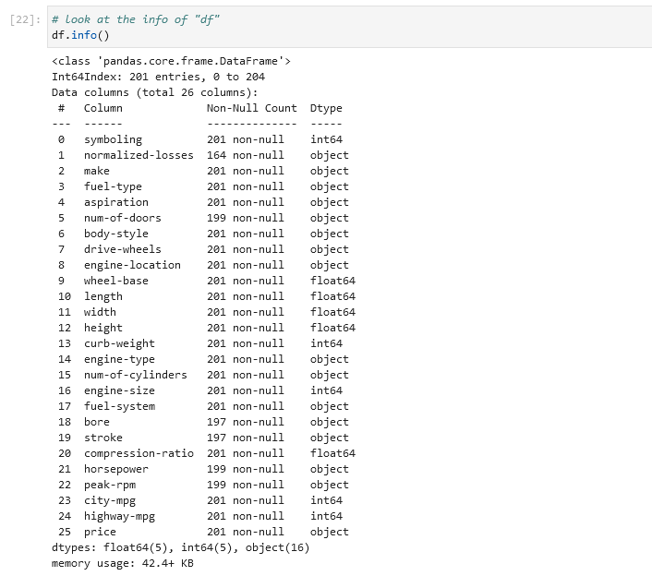
Data Understanding
The Dataset summary of information after dropping missing values in price column (the target variable)
Missing values observed
Normalized losses
Number of doors
Bore
Stroke
Horsepower
Peak-rpm

Slide 14
data PREPARATION
Select Data
Rationale for Inclusion/ Exclusion
Clean Data
Data Cleaning Report
Construct Data
Derived Attributes Generated Records
Integrate Data
Merged Data
Format Data
Reformatted Data

Slide 15
Data Preparation
Based on the summary of assessment, each column has 205 rows of data and seven of the columns containing missing data:
"normalized-losses": 41 missing data
"num-of-doors": 2 missing data
"bore": 4 missing data
"stroke" : 4 missing data
"horsepower": 2 missing data
"peak-rpm": 2 missing data
"price": 4 missing dat

Slide 16
Data Preparation
Missing values were dealt with in the following ways
Replace by mean:
"normalized-losses": 41 missing data, replace them with mean
"stroke": 4 missing data, replace them with mean
"bore": 4 missing data, replace them with mean
"horsepower": 2 missing data, replace them with mean
"peak-rpm": 2 missing data, replace them with mean
Replace by frequency:
"num-of-doors": 2 missing data, replace them with "four".
Reason: 84% sedans is four doors. Since four doors is most frequent, it is most likely to occur
Drop the whole row:
"price": 4 missing data, simply deleting the whole row
Reason: price is what we want to predict. Any data entry without price data cannot be used for prediction; therefore any row now without price data is not useful to us

Slide 17
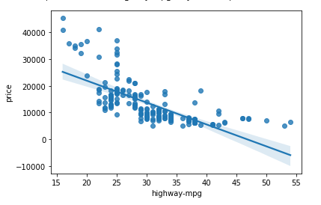
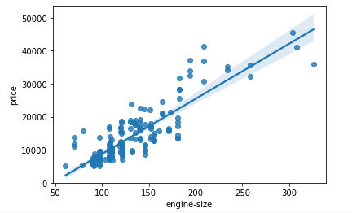
Data Preparation
Analyzing Individual Feature Patterns Using Visualization
As the engine size goes up, the price goes up: this indicates a positive direct correlation between these two variables. Engine size seems like a pretty good predictor of price since the regression line is almost a perfect diagonal line.
As highway-mpg goes up, the price goes down: this indicates an inverse/negative relationship between these two variables. Highway mpg could potentially be a predictor of price

Slide 18
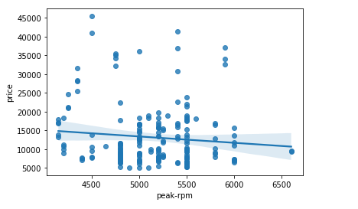
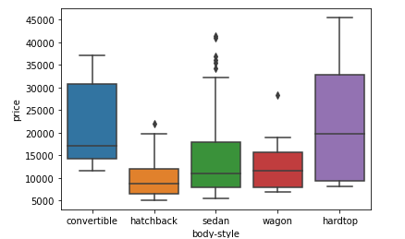
Data Preparation/Exploration
Analyzing Individual Feature Patterns Using Visualization
Peak rpm does not seem like a good predictor of the price at all since the regression line is close to horizontal. Also, the data points are very scattered and far from the fitted line, showing lots of variability. Therefore, it's not a reliable variable.
We see that the distributions of price between the different body-style categories have a significant overlap, so body-style would not be a good predictor of price. Let's examine engine "engine-location" and "price"

Slide 19
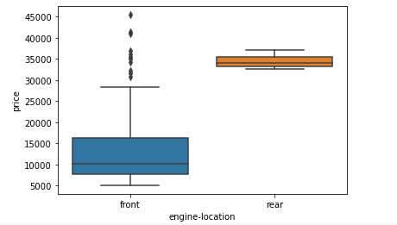
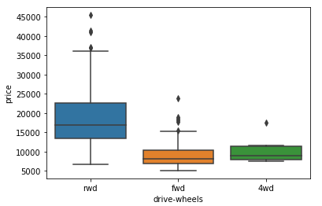
Data Preparation/Exploration
Analyzing Individual Feature Patterns Using Visualization
Here we see that the distribution of price between these two engine-location categories, front and rear, are distinct enough to take engine-location as a potential good predictor of price.
Here we see that the distribution of price between the different drive-wheels categories differs. As such, drive-wheels could potentially be a predictor of price.

Slide 20
MODELING
Select Modeling Techniques
Modeling Technique Modeling Assumptions
Generate Test
Design Test Design
Build Model
Parameter Settings Models Model Descriptions
Assess Model
Model Assessment Revised Parameter Settings

Slide 21
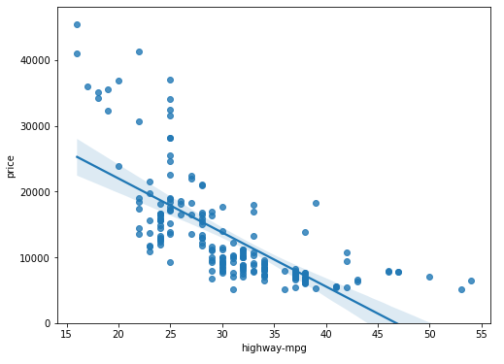
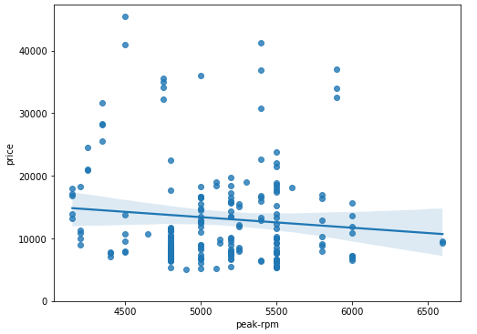
Modeling
Model Evaluation Using Visualization
We can see from this plot that price is negatively correlated to highway-mpg since the regression slope is negative.
Comparing the regression plot of "peak-rpm" and "highway-mpg", we see that the points for "highway-mpg" are much closer to the generated line and, on average, decrease. The points for "peak-rpm" have more spread around the predicted line and it is much harder to determine if the points are decreasing or increasing as the "peak-rpm" increases.

Slide 22
Modeling
Decision Making: Determining a Good Model Fit
Three Model used:
Simple Linear Regression
Multiple Linear Regression
Polynomial Linear Regression
Comparing these three models used in the model development, we conclude that the MLR model is the best model to be able to predict price from our dataset. This result makes sense since we have 27 variables in total and we know that more than one of those variables are potential predictor of the final car price

Slide 23
EVALUATION
Evaluate Results
Assessment of Data Mining Results w.r.t. Business Success Criteria Approved Models
Review Process
Review of Process
Determine Next Steps
List of Possible Actions Decision

Slide 24
Model Evaluation & Validation
Decision Making: Validating a Good Model Fit
There are 3 main metrics for model evaluation in regression:
R Square/Adjusted R Square.
Mean Square Error(MSE)/Root Mean Square Error(RMSE)
Mean Absolute Error(MAE)
Conclusion:
Comparing these three models used in the model development, we conclude that the MLR model is the best model to be able to predict price from our dataset. This result makes sense since we have 27 variables in total and we know that more than one of those variables are a potential predictor of the final car price

Slide 25
CONCLUSION
Findings…
The following are the outcome of the analysis
The forecast suggests that the selling price of used cars will fairly be in the same range as of now in the future, but will vary depending on the following features:
Engine size
Engine location
Drive wheels
The power of a car(horsepower), the fuel consumption rate(highway-mpg), and the fuel type (Gas or Diesel) are important factors that influence the selling price of a car in the used car market.
Top car make is Toyota

Slide 26
THANK YOU

